Slide 1
Feel Good food The App
Technical Walkthrough

Slide 2

What It’s all about
The purpose of this application
The Technologies and Tools used
Connection between the Frontend and Backend
Hierarchical Structure of the project

Slide 3
Single Purpose Application
The app is made for people that need help controlling the things they eat.
We provide textual feedback every time a user adds a food to his/her list.
To help people get a grip on negative eating habits.

Slide 4
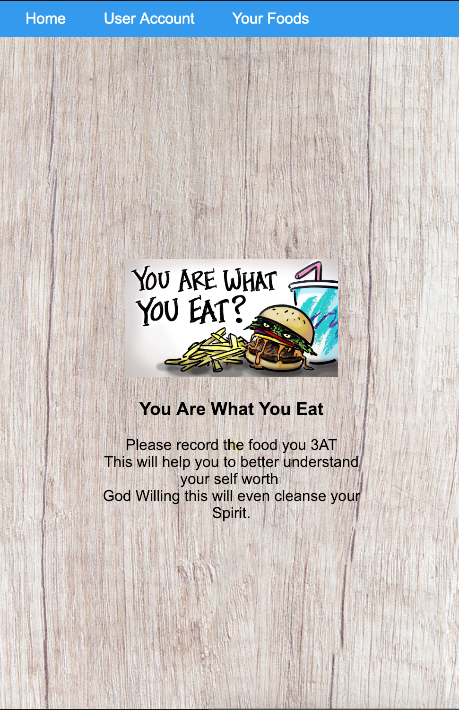
The User Interface
The front end was implemented using a very powerful Open Source JavaScript library:-
ReactJs
To run ReactJs I needed a Framework for JavaScript Execution:-
Node.js

Slide 5
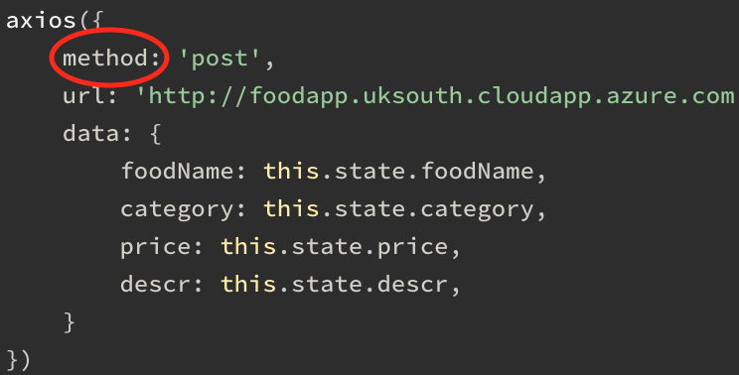
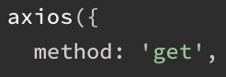
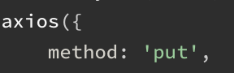
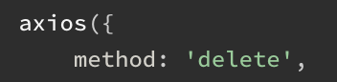
NPM - Package Manager
npm comes with Node.js
It is the Package and Library manager for JavaScript
Axios – Used to make HTTP requests.
Allowed me to:-
Create – post
Read - get
Update - put
Delete - delete

Slide 6
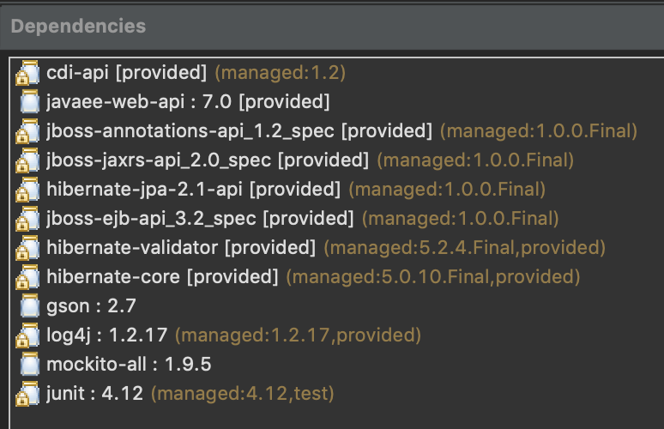
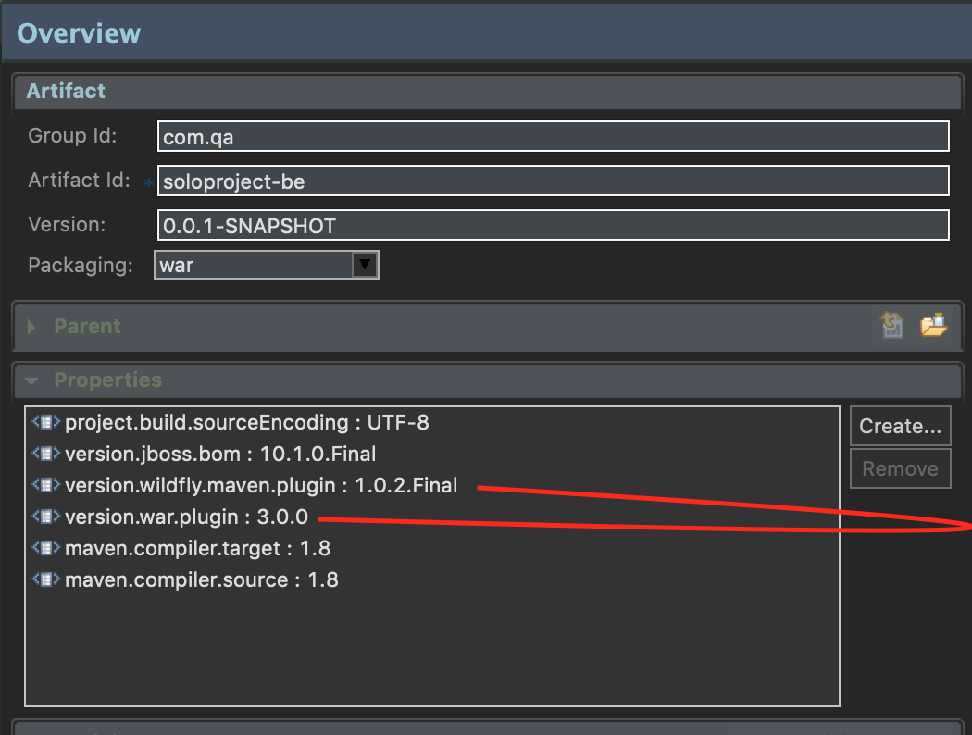
The JavaEE backend
A Project Object Model or POM
A XML file that contains information about the project and configuration details
Used by Maven to build the project into a war package
The Maven JavaEE project was deployed using:-
WildFly Server

Slide 7
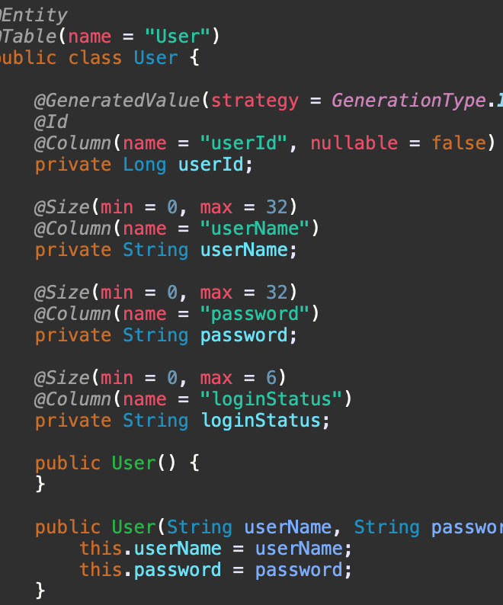
Creating Database Tables in Java
This was achieved through using:-
javax.persistence package (JPA)
Java Persistence is the API for the management for persistence and object/relational mapping
@Entity – shows what class should be persisted into the database.
@Table – Defines the table name
@id – defines what variable is used as a auto generated id.
@Column – Defines column names for table per variable in class.

Slide 8
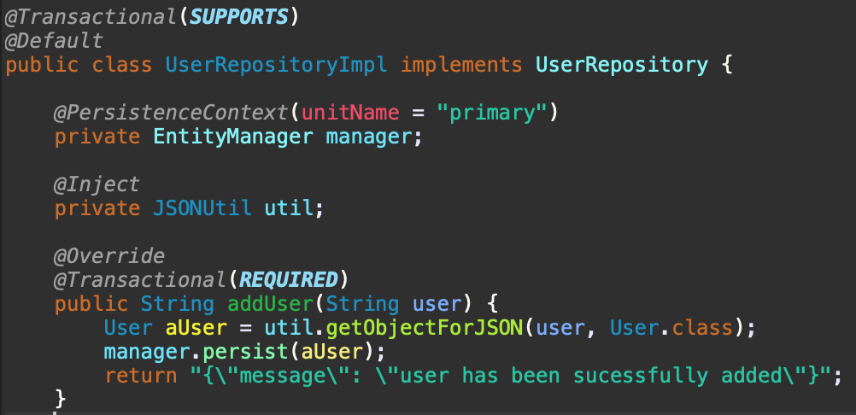
Implementation of Functions -
Continued use of the JPA
@Transactional – a proxy is created the same as the class annotated upon
Automatically commits/rolls back the changes accordingly
Entity Manager – allows data to be to searched, add, and deleted from the DB
@Inject – provides the application the ability to create references of an instance of a class.
Enforces SOLID OOP principles.

Slide 9
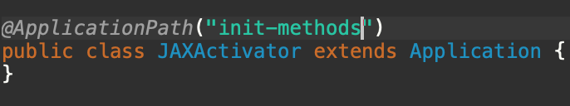
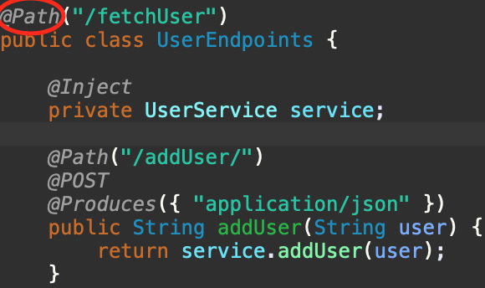
JAX-RS for receiving HTTP requests
@ApplicationPath – the first entry point to get to functionality.
@Path – allows sub paths to be defined
@POST – indicates the method will respond to a post request and call the given function

Slide 10
Docker-ized
Using the containers in docker allowed me to package up the application with all of the parts it needs such as libraries and other dependencies, and ship it all out as one package.
Those built images have been pushed to docker hub. And can be accessed anywhere at anytime on any machine with only docker installed.
Simplified maintenance – Docker reduces effort and risk of problems with application dependencies.

